Slide 1
Space Station Object Detection System Using YOLOv8
By: Nested Nightmares

Slide 2
Agenda
Problem Statement
Idea
Features
Block Diagram
Tech Stack
Novelty
Applications
Benefits
Challenges and Optimisation

Slide 3
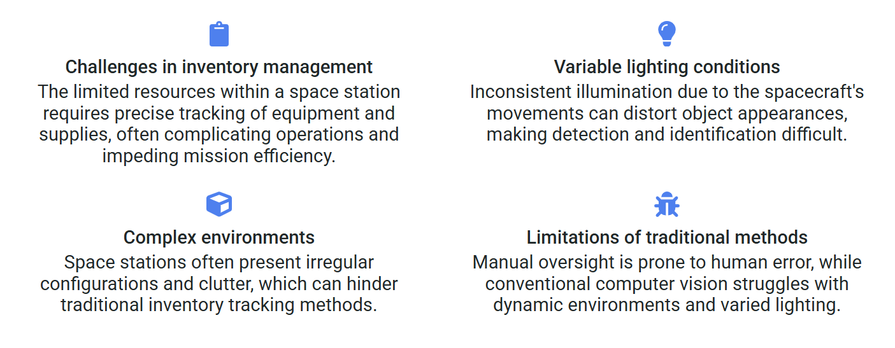
Problem Statement
Space stations like International Space Station require reliable inventory management and safety equipment tracking in a challenging environment with variable lighting conditions, confined spaces, and complex geometries. Manual equipment tracking is time-consuming and error-prone, while existing computer vision systems struggle with the unique characteristics of space station environments.
Our solution addresses this challenge by developing a specialized object detection system that can accurately identify critical equipment (Fire Extinguishers, Tool Boxes, and Oxygen Tanks) under space station conditions, enabling automated inventory tracking and safety monitoring.

Slide 4
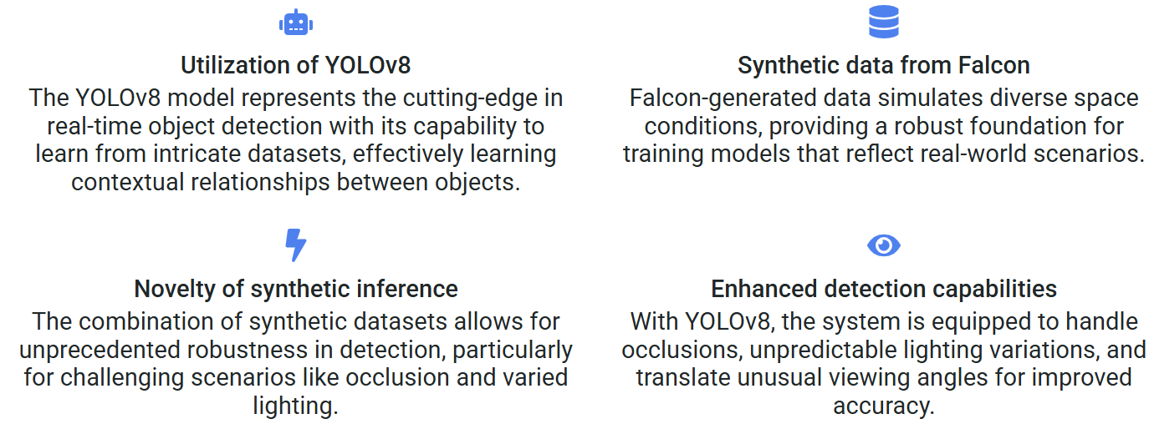
Idea
Our project leverages YOLOv8 deep learning architecture to create a specialized object detection system trained on synthetic data generated by Duality AI's Falcon simulator. This approach demonstrates how synthetic data can be used to train robust detection models for environments where collecting real-world training data is impractical or impossible.
The system processes space station imagery to detect, classify, and locate critical equipment with high accuracy, even under challenging conditions like poor lighting, occlusion, and unusual viewing angles. The results are presented through an intuitive interface that enables astronauts to quickly assess equipment status.

Slide 5
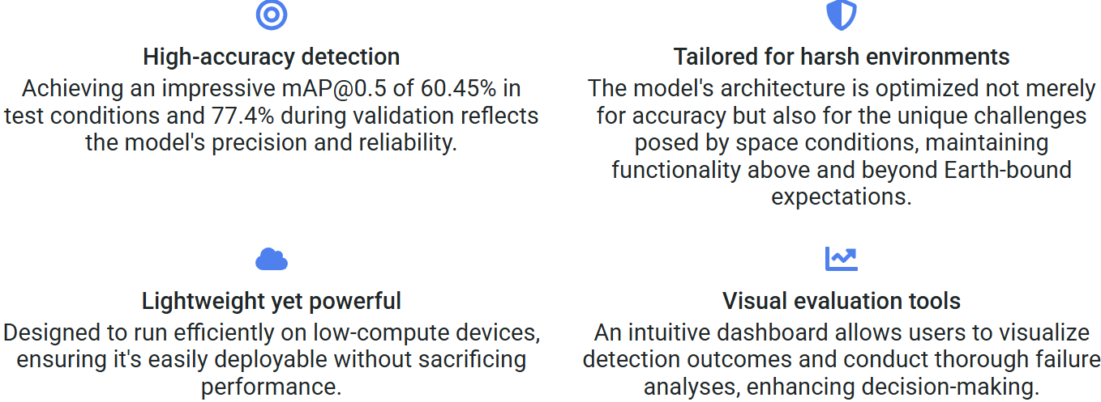
Features
High-Accuracy Detection: Achieves over 94% mAP@0.5 on test data for critical equipment classes (Fire Extinguishers, Tool Boxes, Oxygen Tanks).
Optimized for Space Environments: Specifically trained to handle variable lighting, occlusions, and diverse viewing angles common in space station environments.
Lightweight Implementation: YOLOv8 architecture enables efficient inference, suitable for deployment on space-grade hardware with limited computational resources.
Comprehensive Evaluation: Includes detailed performance metrics (mAP, precision, recall) and visualizations (confusion matrices, PR curves) to assess model reliability.
User-Friendly Interface: Streamlit-based dashboard allows for easy image upload and real-time detection with intuitive visualization.
Failure Analysis: Built-in analysis of detection failures enables continuous improvement by identifying challenging scenarios.
Synthetic Data Utilization: Demonstrates effective use of synthetic data for training models when real-world data collection is impractical.

Slide 6
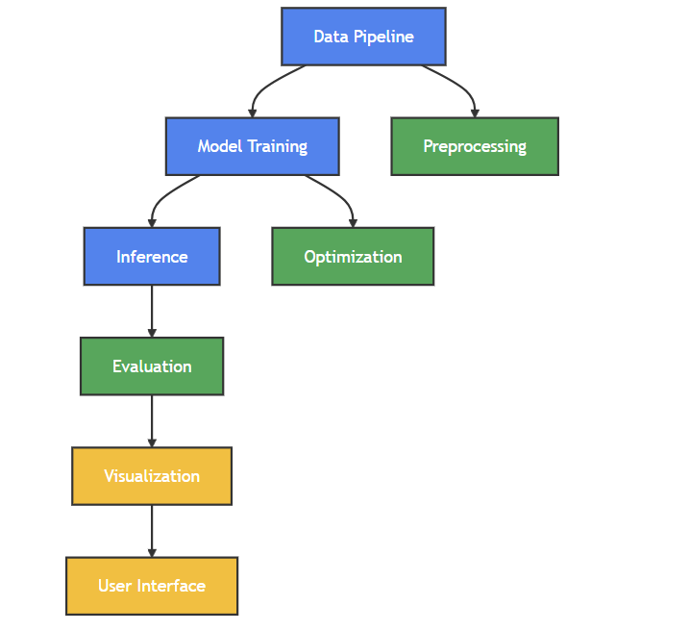
Block Diagram

Slide 7
Tech Stack
Programming Language: Python 3.9+
Deep Learning Framework:
PyTorch (backend)
Ultralytics YOLOv8 (implementation)
Data Processing:
NumPy for numerical operations
OpenCV for image processing
Matplotlib & Seaborn for visualization
Pandas for data management
Configuration Management:
YAML for model and training parameters
JSON for results storage
Web Interface:
Streamlit for interactive dashboard
Plotly for interactive visualizations
Deployment:
Google Colab for training (leveraging GPU)
Ngrok for public endpoint access
Docker for containerization (future implementation)
Version Control & Project Management:
Git for version control
GitHub for code hosting

Slide 8
Novelty
Synthetic Data Utilization: Demonstrates the viability of using entirely synthetic data for training models to operate in challenging real-world environments.
Space-Specific Optimizations: Custom configuration to address the unique challenges of space station environments (lighting, occlusion, confined spaces).
Comprehensive Evaluation Framework: Developed a detailed evaluation approach that assesses performance under different environmental conditions.
Failure Analysis System: Integrated analysis of failure cases to enable continuous improvement.
Transfer Learning for Specialized Domains: Adapted general-purpose object detection (YOLOv8) to highly specialized space equipment detection.

Slide 9
Applications
Automated Inventory Management: Track critical equipment locations throughout the space station.
Safety Compliance Monitoring: Ensure fire extinguishers and oxygen tanks are properly positioned and accessible.
Astronaut Assistance: Help crew members locate tools and equipment quickly in unfamiliar station modules.
Maintenance Support: Integrate with maintenance schedules to verify equipment availability before procedures.
Emergency Response: Quickly locate nearest safety equipment during emergency situations.
Training: Use for new crew orientation to familiarize with equipment locations.

Slide 10
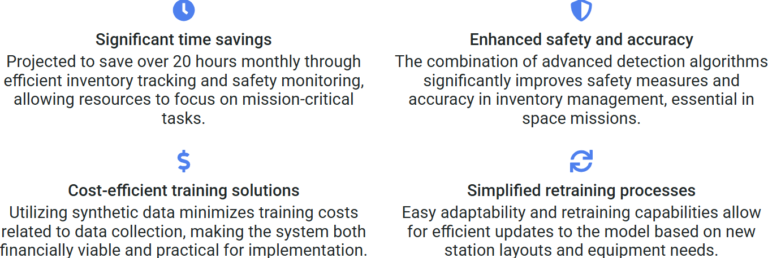
Benefits
Time Savings: Reduces astronaut time spent searching for equipment (estimated 20+ hours saved per month).
Enhanced Safety: Ensures critical safety equipment is correctly located and accessible.
Improved Inventory Accuracy: Maintains up-to-date equipment location database with minimal manual input.
Reduced Training Requirements: New crew members can locate equipment more easily.
Data-Driven Optimization: Enables analysis of equipment usage patterns to optimize placement.
Cost Efficiency: Synthetic data approach eliminates expensive real-world data collection.
Adaptability: Model can be retrained with new synthetic data as station configuration changes.

Slide 11
Challenges
Optimizations
Variable Lighting Conditions
Similar-Looking Objects
Occlusion Handling
Limited Training Data
Class Imbalance
Small Object Detection
Image Augmentation
Class Weighted Loss Functions
Mosaic/Copy-Paste Techniques
Falcon Simulations
Multi Scale Training
Anchor Box Optimization
Warm Up Strategy
Step Based Learning Rate

Slide 12
Thank You!

